Slide 1
Topic:CaptionBot For Assistive Vision
Minor Project Final Report
Project Members
Mohini Prakash 1806182
Vishal Raj 1806186
Krishna Singh 1806187
MENTORED BY
Dr. Dinesh Dash
(ASSISTANT PROFESSOR, NIT PATNA)

Slide 2
INTRODUCTION
Caption Bot for assistive vision is a Deep Learning Model which will generate appropriate captions for the different images fed to model.
Our model when implemented as application will assist visually impaired in travelling by taking multiple pictures from the environment time to time and generating captions for them. These captions can be fed to visually impaired person’s ear by means of microphone.

Slide 3
Other Applications
Self driving cars : Automatic driving is one of the biggest challenges and if we can properly caption the scene around the car, it can give a boost to the self driving system.
CCTV cameras are everywhere today, but along with viewing the world, if we can also generate relevant captions, then we can raise alarms as soon as there is some malicious activity going on somewhere.

Slide 4
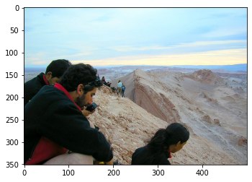
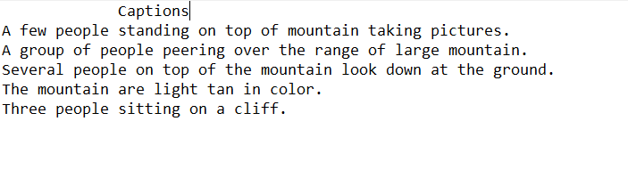
Datasets
Dataset: Flicker 8k dataset https://www.kaggle.com/adityajn105/flickr8k/activity
This Dataset has 8000 images and each image has 5 captions.
We will use 1600 images and their captions.
Image and its captions present in dataset:

Slide 5
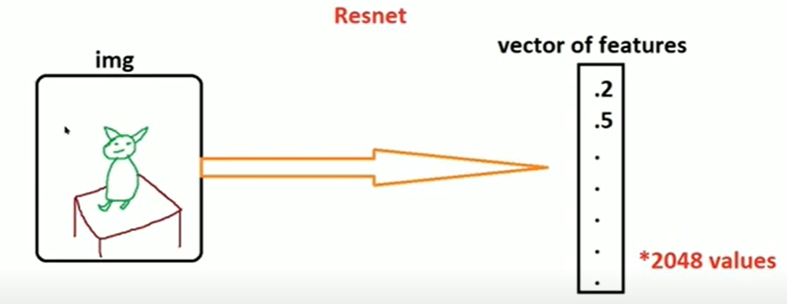
Preprocessing Images
All the images are converted to vector of features.
Resnet50 is used as feature extractor which has total 50 layers.
We will use last second layer of Resnet which is vector of size 2048.
We will use last second layer of Resnet which is vector of size 2048.

Slide 6
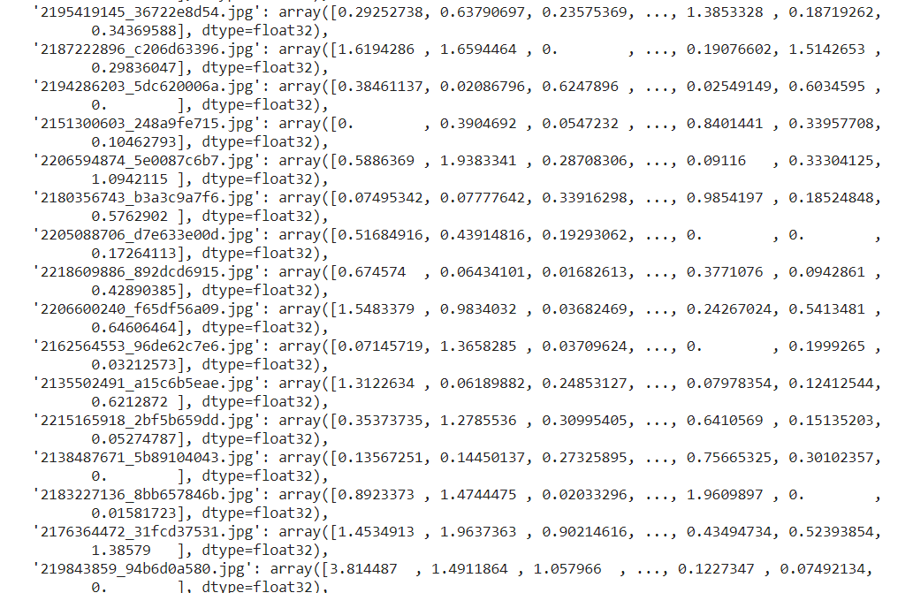
Preprocessed Image Feature Dictionary

Slide 7
Preprocessing Text
Captions Dictionary is made which contain image name as key and all 5 captions as value
Data Cleaning is done in captions which removes single letter words and punctuations.
Vocabulary count is done which will count number of times a word is occurring in captions and store it into dictionary.
Based on the Vocabulary and their count , all 5 captions of images are changed from text to digits where each word of caption is changed to digit in caption dictionary.

Slide 8
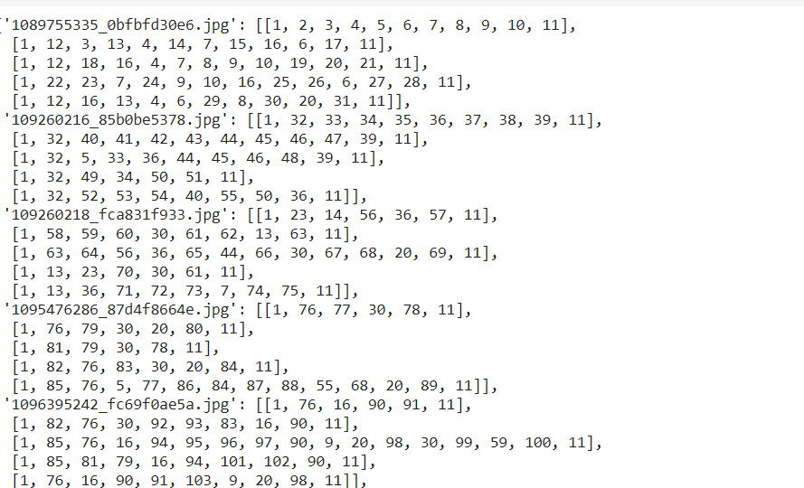
Preprecessed Captions Dictionary

Slide 9
Pictorial Representation
Image Vector
Partial Caption
Next Word

Slide 10
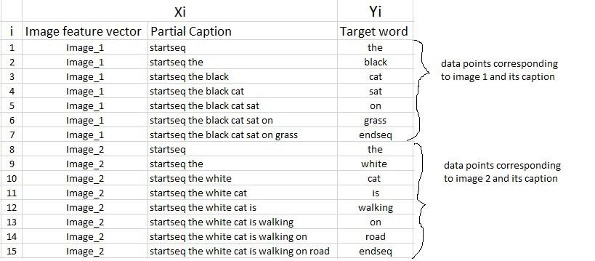
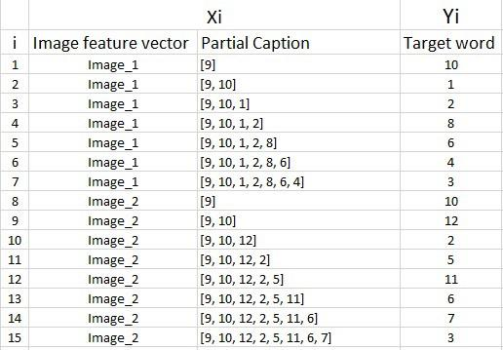
Pictorial Representation

Slide 11
Building Generator Function
Generator function is built to generate three things:X,Y_in&Y_out
X=image vectors
Y_in=Previous Output which is fed as input
Y_out=Output Generated by taking X and Y_in as input
Generator function takes input as images features dictionary (which store key as image name and value as feature vector of that image) and captions dictionary.

Slide 12
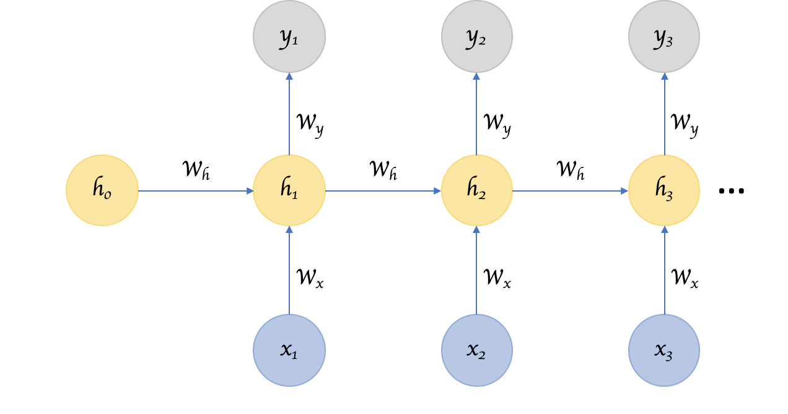
Recurrent Neural Network
Recurrent Neural Network remembers the past and it’s decisions are influenced by what it has learnt from the past.
Recurrent Neural Network is suited for handling sequential data which feed forward neural network cannot handle.
Previous output and current input are sent as input to RNN.

Slide 13
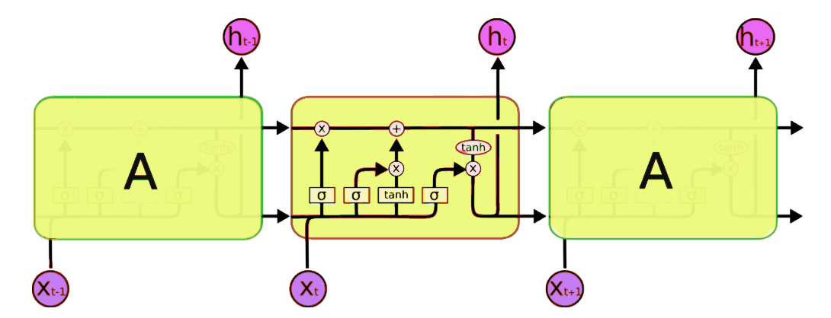
LSTM
Since traditional RNNs have short term memory problem .So Long Short Term Memory networks – usually just called “LSTMs” – are a special kind of RNN, capable of learning long-term dependencies

Slide 14
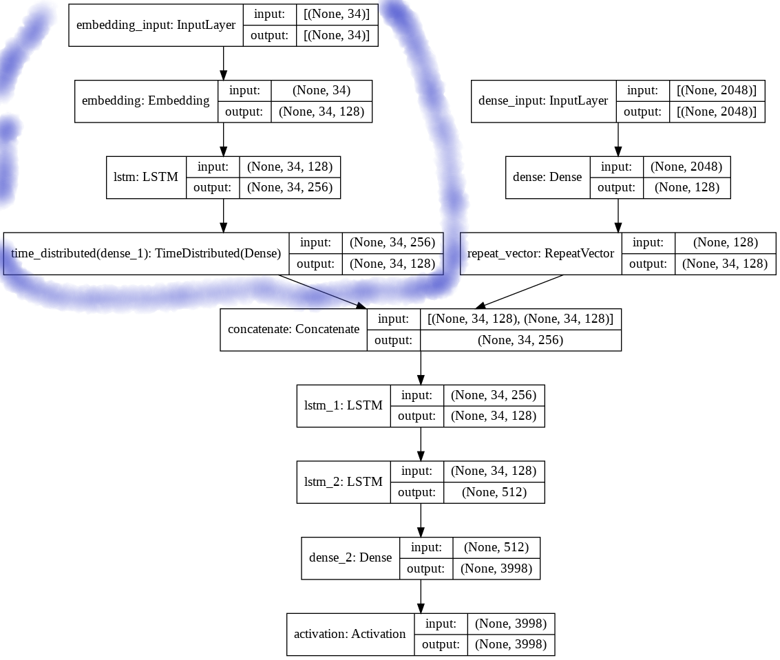
Model
Marked section shows different layers used in sequence to process the captions through model.
Layers used in sequence are Embedding Layer , Lstm layer and TimeDistributed dense layer.

Slide 15
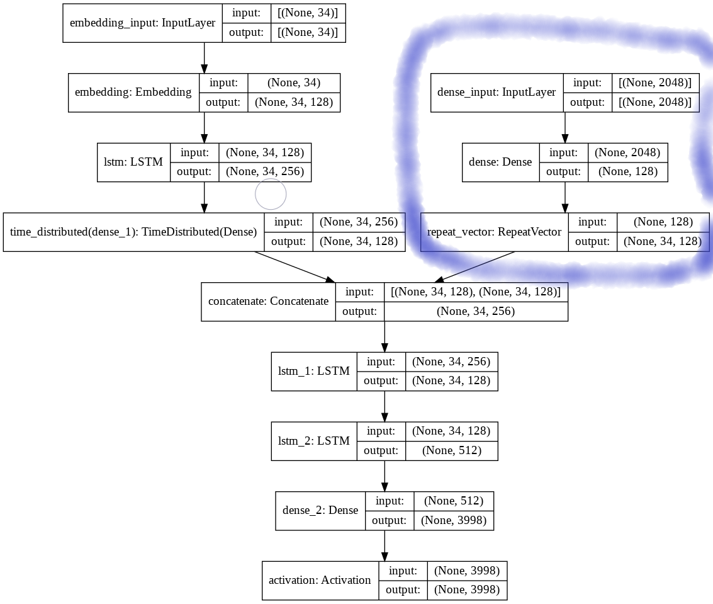
Model
Marked section shows different layers used in sequence to process the image through our model.
Layers used in sequence are Dense Layer and Repeatvector.

Slide 16
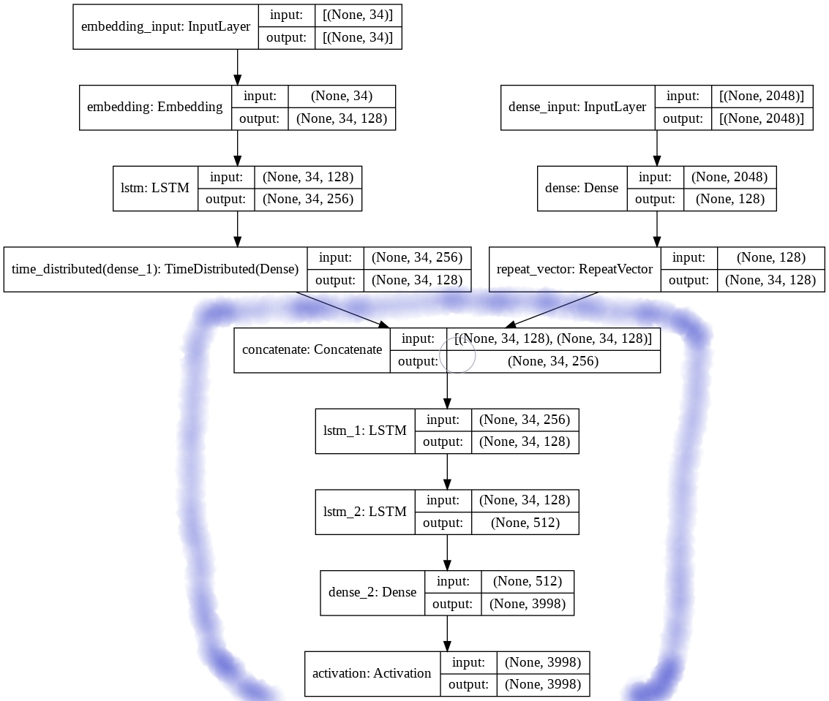
Model
Marked Section shows the concatenation of both previous layers sequence.
After concatenating two layers of lstm and one dense layer is added along with activation function.

Slide 17
Training the Model
Model is trained by feeding input as X and Y_in and output as Y_out.
Model is trained for 10 epochs.
Batch size is kept as 512.
Loss function used is categorical_crossentropy.
Optimizer used is RMSprop.

Slide 18
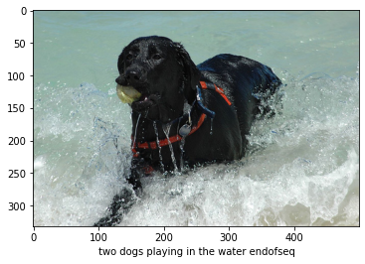
Prediction of Caption
We will make inverse dictionary which is opposite of vocabulary dictionary.
Based on inverse dictionary we will generate captions of the fed image.
Finally we will predict the caption below the given image.

Slide 19
Conclusion
From the prediction of the caption of 5 images we can understand that captions are giving what is in the image with some error.
But we can fix these errors by training data on larger inputs as we have only trained on 1600 images.
We can minimise the loss and increase the accuracy in prediction of caption also by training for more number of epochs.

Slide 20
References
Understanding LSTM Networks:
http://colah.github.io/posts/2015-08-Understanding-LSTMs/
Image Captioning Article: https://towardsdatascience.com/image-captioning-with-keras-teaching-computers-to-describe-pictures-c88a46a311b8
Resnet: https://medium.com/@venkinarayanan/tutorial-image-classifier-using-resnet50-deep-learning-model-python-flask-in-azure-4c2b129af6d2
Stack Overflow:
https://stackoverflow.com/

Slide 21
Thank You

